Slide 1
Semi-Automated Detection of Sanitization, Authentication and Declassification Errors in UML State Charts
Md Adnan Rabbi
Department of Computer Science
Technical University of Munich, Germany
Notes:
Slide show presentation view

Slide 2
Agenda
Introduction
Background
Challenges and Annotation Language Extension
Implementation
Experiments
Conclusion and Future Work

Slide 3
Introduction
What do we want to achieve in this work?
Develop a tool which can help to detect (sanitization, declassification and authentication) (*) errors during software design phase.
What is the problem with detection of (*) errors during SW Dev.?
Usually (*) are addressed during coding phase.
What other solution exist?
To the best of our knowledge there are no other tools which can check (*) during design.
Where do these tools lack?
They don’t have support for checking (*) in models.
What is our insight?
(*) can be addressed using UML state charts, annotation language and other tools.
What are our contributions?
Ann. Lang. extensions, C code gen., 3 info. flow checkers, UML seq. diagram gen., IEEE QRS-C’15 Publication

Slide 4
Agenda
Introduction
Background
Challenges and Annotation Language Extension
Implementation
Experiments
Conclusion and Future Work

Slide 5
Background I
Sanitize User Input:
Process of removing information (forbidden characters, sensitive, confidential etc.) from user input.
In order to protect SQL injection, cross-site scripting (XSS) attacks sanitization can be used.

Slide 6
Background II
Authenticate User Access:
Authentication is the mechanism which confirms the identity of users trying to access a system.
Generally, this is handled by passing a key with each request.
Often called an access token, user verification using user id and password.

Slide 7
Background III
Declassify Confidential Information:
Enabling information flow controls with expressive information release or declassification policies.
Lowering the security classification of selected information.
Sometimes encrypting/decrypting policies.

Slide 8
Background IV
Information flow propagation theory can be used to detect these types of bugs.
The UML model is annotated with information flow annotations.
The UML model is converted to code containing annotations.
A control flow graph is generated from the generated source code.
Paths in the control flow graph are checked in order to detect information flow error based on the previous added annotations.

Slide 9
Agenda
Introduction
Background Information
Challenges and Annotation Language Extension
Implementation
Experiments
Conclusion and Future Work

Slide 10
Challenges and Annotation Language Extension I
Detect information flow bugs in UML state charts and C code.
An annotation language which can be used to annotate UML state charts and code.
Information flow restrictions which can be added during two software development phases (design and coding).
Notes:
An annotation language which can be used to annotate UML state charts and code by inserting information flow restrictions during two software development phases (design and coding)

Slide 11
Challenges and Annotation Language Extension II
Annotation Type | Annotation Tag | Description
@function | Authentication,declassification, sanitization | authenticate, declassifies and sanitizes information
@parameter | authenticated H/L declassified H/L sanitized H/L | authenticated , declassified and sanitized with High/Low tags
@variable | confidential H/L, source H/L | confidential and source with High/Low tags
Notes:
An annotation language which can be used to annotate UML state charts and code by inserting information flow restrictions during two software development phases (design and coding)

Slide 12
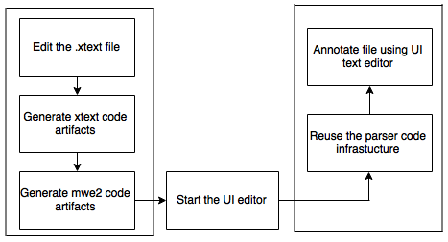
Challenges and Annotation Language Extension III
Annotation Language Design Process:
Figure 1: Annotation language design process
Notes:
An annotation language which can be used to annotate UML state charts and code by inserting information flow restrictions during two software development phases (design and coding)

Slide 13
Agenda
Introduction
Background Information
Challenges and Annotation Language Extension
Implementation
Experiments
Conclusion and Future Work

Slide 14
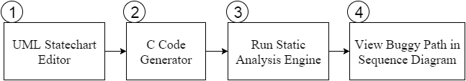
Implementation I
Overview of System Architecture
UML Statechart Editor
C Code Generator
Static Analysis Engine (three new checkers added)
Sequence Diagram Generator

Slide 15
Implementation II
Tools and Technologies
Eclipse Xtext
Eclipse Xtend
YAKINDU SCT Editor
EMF (Eclipse Modeling Framework)

Slide 16
Agenda
Introduction
Background Information
Challenges and Annotation Language Extension
Implementation
Experiments
Conclusion and Future Work

Slide 17
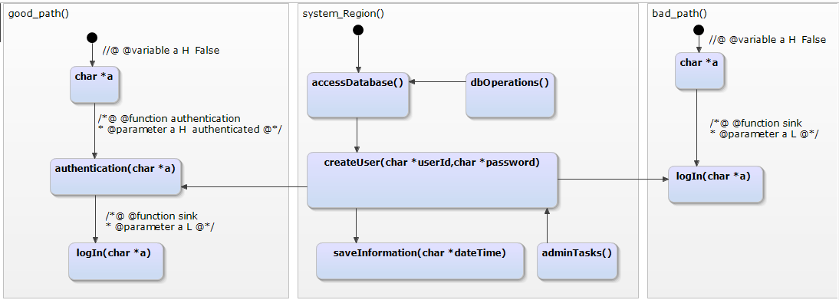
Experiments I
UML StateChart Model:
Figure 2: Authentication scenario (CWE-306) statechart model

Slide 18
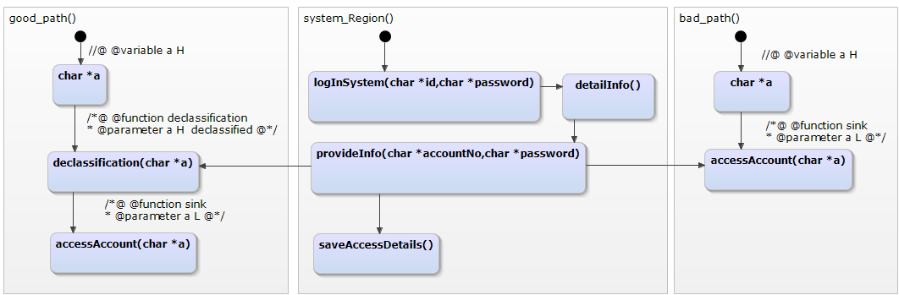
Experiments II
UML StateChart Model:
Figure 3: Declassification scenario statechart model

Slide 19
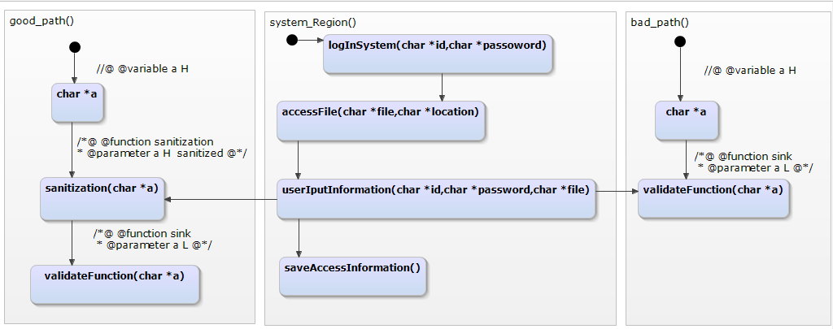
Experiments III
UML StateChart Model:
Figure 4: Sanitization scenario (CWE-78) statechart model

Slide 20
Experiments IV
C Code Generator:
Using Eclipse Xtend.
Extended YAKINDU SCT Editor.
Generated C code files sample:
C header file (.h file) contents:
/*@ @function sink
* @parameter a L @*/;
void logIn(char *a)
… … … … … … … …

Slide 21
Experiments V
C source file (.c file) contents:
void good_path(){
logIn(a) ;
//@ @variable a H False ;
char *a;
authentication(a);
saveInformation(dateTime);
… … … … … … … }

Slide 22
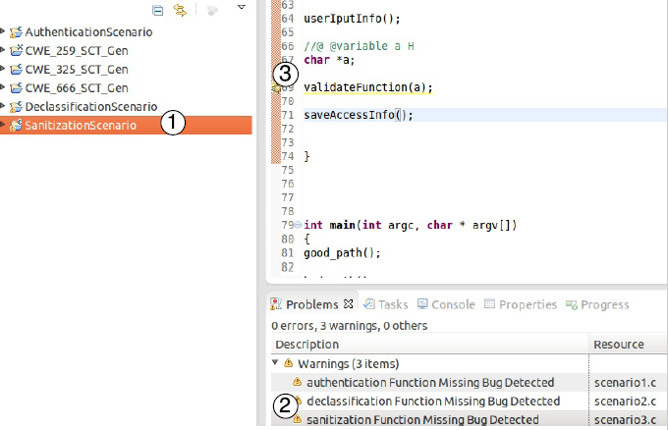
Experiments VI
Figure 5: Bug Detection with Static Analysis Engine

Slide 23
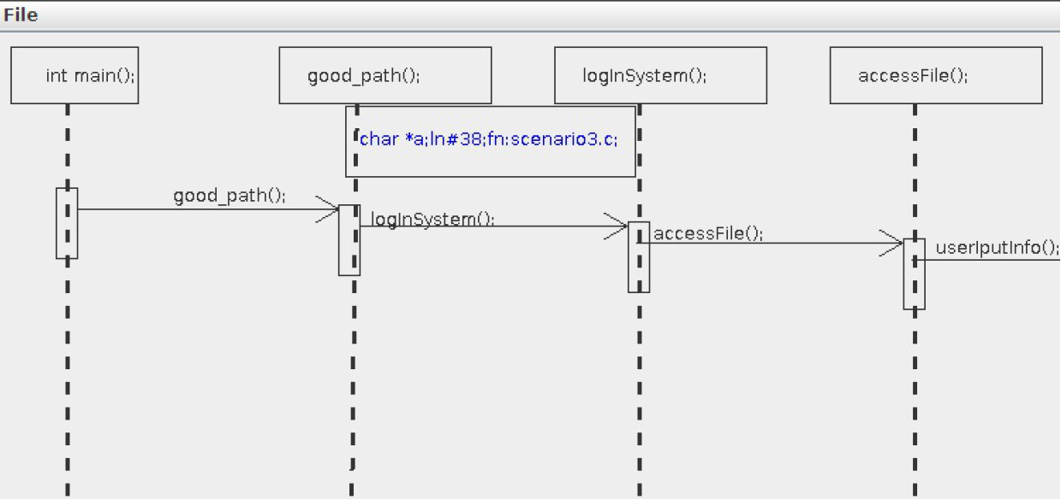
Experiments VII
Sequence Diagram Generator:
Figure 6: View Buggy Path in UML Sequence Diagram

Slide 24
Agenda
Introduction
Background Information
Challenges and Annotation Language Extension
Implementation
Experiments
Conclusion and Future Work

Slide 25
Conclusion and Future Work
Conclusion:
A keyword-based annotation language was developed that can be used for annotating UML state charts and C code.
Detect information flow bugs automatically and it is applicable to real life scenarios.
In order to detect authentication, declassification and sanitization errors, our tool can be used in the design and coding phase of software development.
Notes:
System can be extended for source code editor as a pop-up window based proposal editor to add/retrieve annotation to/from a library

Slide 26
Conclusion and Future Work
Future Work:
Our tool can be extended for source code editor as a pop-up window based proposal editor.
The editor can be extended for other types of diagrams.
The annotation lang. can be extended in order to deal with other scenarios.
Notes:
System can be extended for source code editor as a pop-up window based proposal editor to add/retrieve annotation to/from a library
UML models can be also in future simulated in order to check for other types of bugs.

Slide 27
Q/A?

Slide 28
Thank You ALL !!!

